Slide 1
Secure data hiding in images using steganography
CAPSTONE PROJECT
Presented By: Vikas Avinash Jadhav
Student Name : Vikas Avinash Jadhav
College Name & Department : Rajarshi Shahu Institute Of Management , Chatrapati Sambhajinagar (Aurangabad)

Slide 2
OUTLINE
Problem Statement
Technology used
Wow factor
End users
Result
Conclusion
Git-hub Link
Future scope

Slide 3
Problem Statement
With increasing cyber threats, secure communication has become a necessity. Traditional encryption methods can attract attention, making data transmission susceptible to attacks. Steganography provides an alternative by hiding sensitive information inside digital images, making it nearly undetectable.

Slide 4
Technology used
Programming Language: Python
Libraries: OpenCV, NumPy, PIL (Pillow), Stegano
Concepts: Least Significant Bit (LSB) steganography, image processing, and cryptographic techniques

Slide 5
Wow factors
Hides data within images without noticeable visual changes.
Can be used alongside encryption for double security.
The extracted data is lossless and can be retrieved with precision.
Can be implemented for secure message transmission in covert operations.

Slide 6
End users
Journalists and whistleblowers for secure communication.
Government agencies and military for confidential data transmission.
Corporate sectors to protect sensitive information.
General users who want to safeguard personal messages.

Slide 7
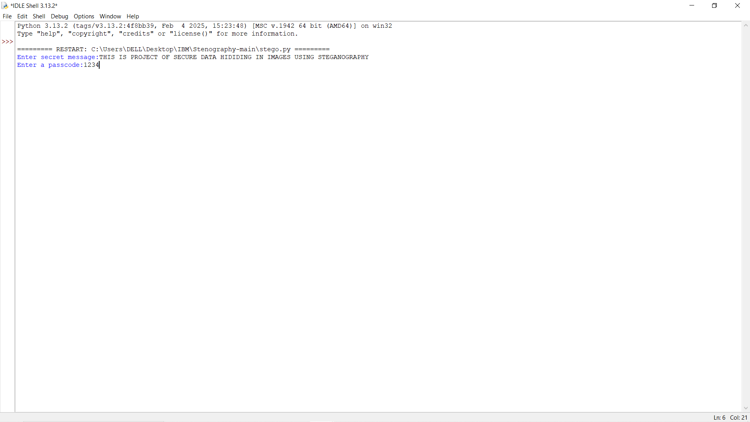
Results

Slide 8
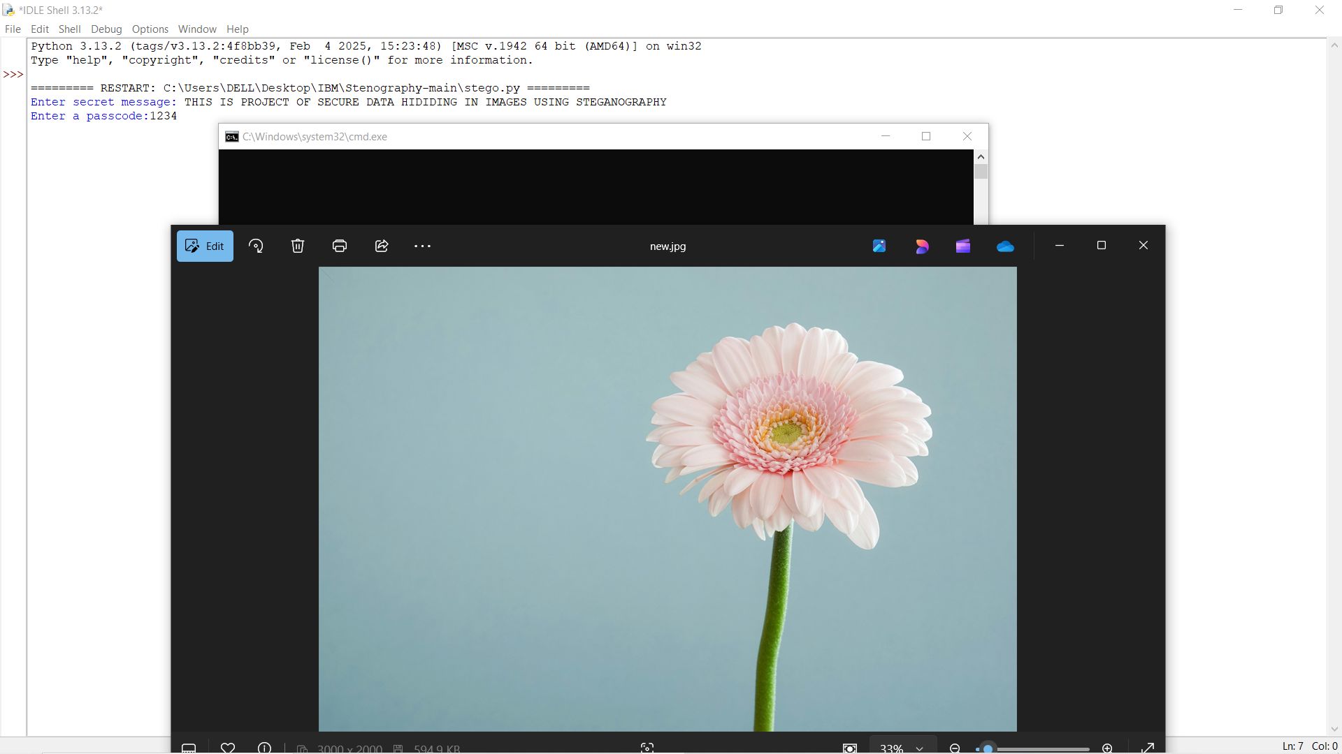
Results

Slide 9
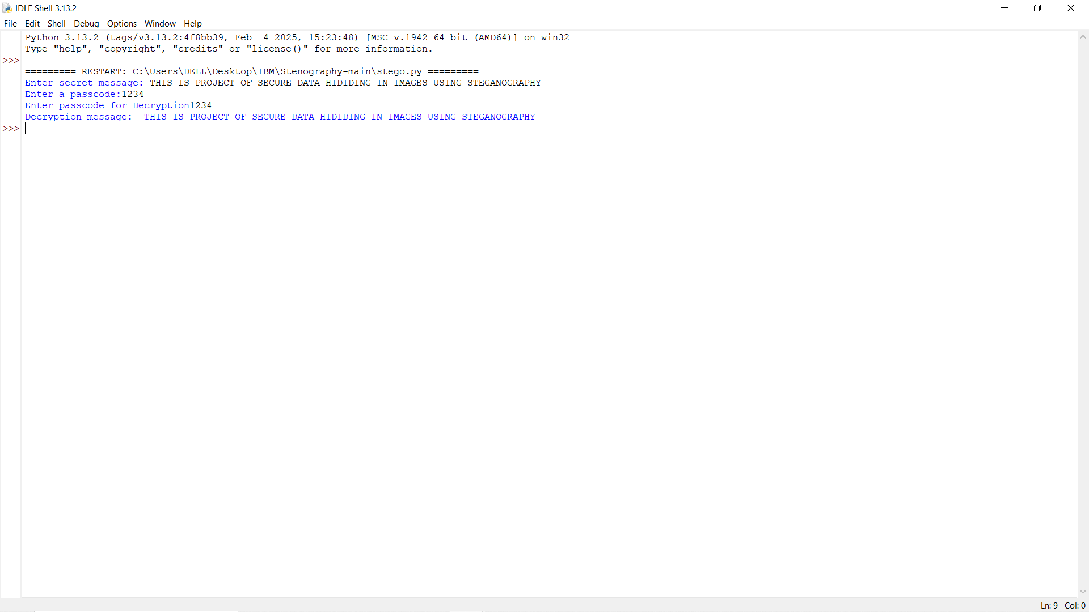
Results

Slide 10
Conclusion
Steganography offers a secure and efficient way to transmit sensitive data without attracting unwanted attention. By leveraging Python and LSB techniques, this project demonstrates how data can be securely embedded and retrieved from images with minimal risk of detection.

Slide 11
GitHub Link
https://github.com/vikasajadhav/AICTE-PROJECT.git

Slide 12
Future scope(optional)
Implementing advanced encryption before hiding data to enhance security.
Exploring different steganographic methods like frequency-domain hiding.
Developing a user-friendly interface for broader accessibility.
Integrating AI to detect and prevent steganographic attacks.

Slide 13
THANK YOU

